Slide 1
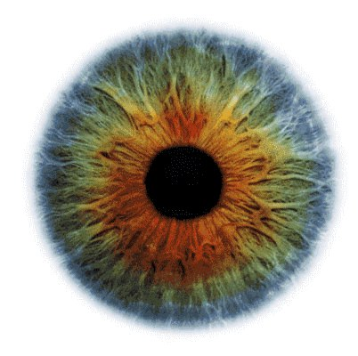
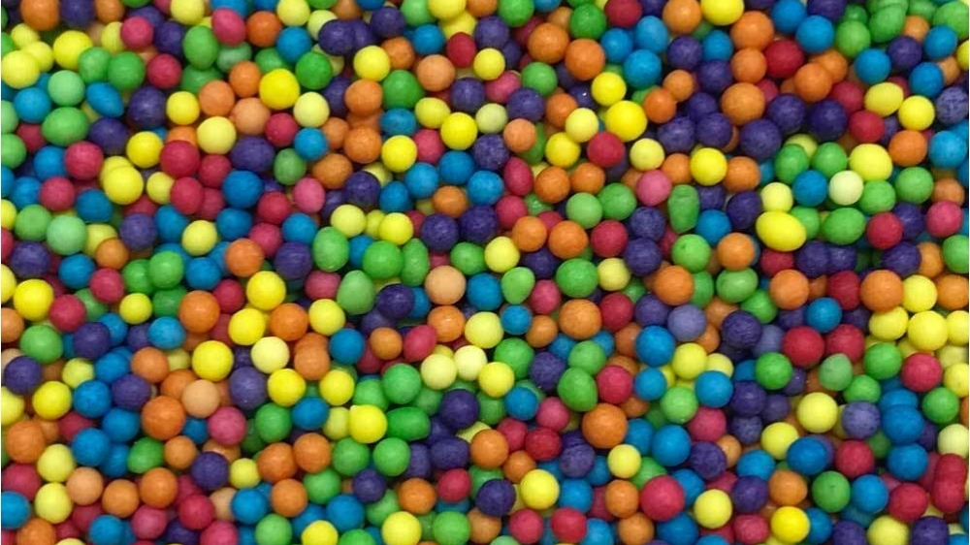
Computer Vision

Slide 2

Computer Vision
Computer Vision

Slide 3
Computer Vision
• Face and object detection
• Facial recognition
• Object tracking

Slide 4
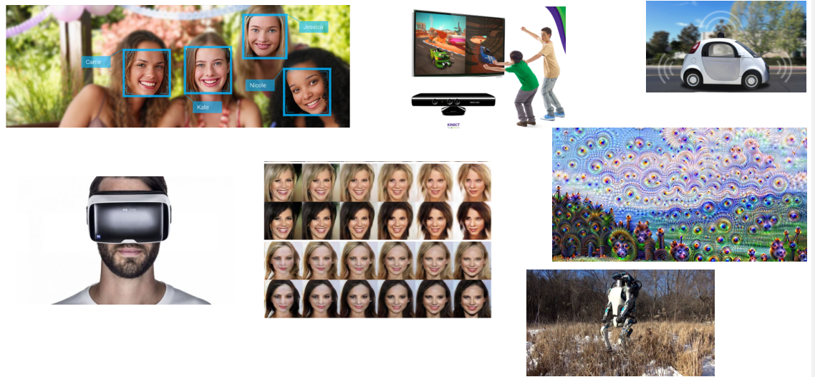
CV Applications

Slide 5
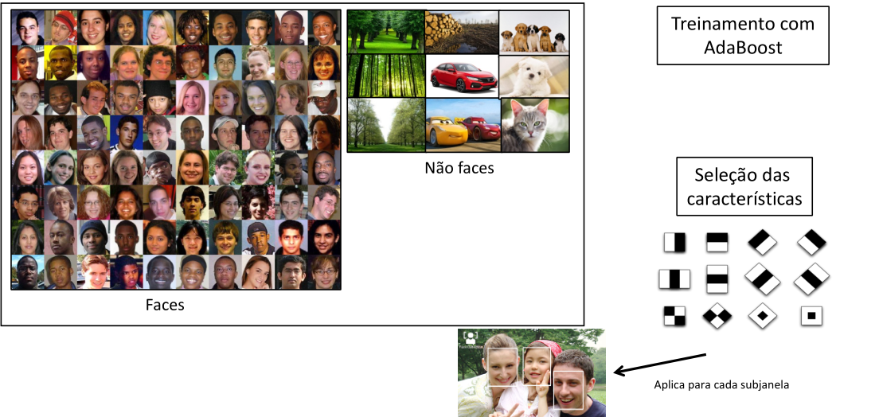
Cascade Classifier
AdaBoost
Training
Non-Faces
Features
Selection
Faces
Apply to each subwindow

Slide 6
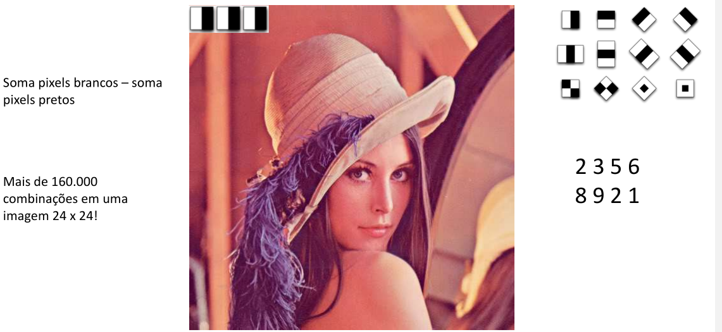
Cascade Classifier
Add white pixels
addblack pixels
More than 160,000
combinations in one
24x24 image!

Slide 7
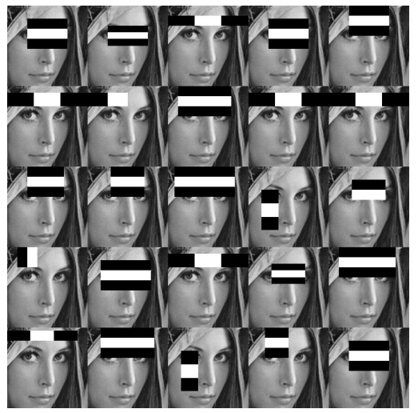
Cascade Classifier

Slide 8
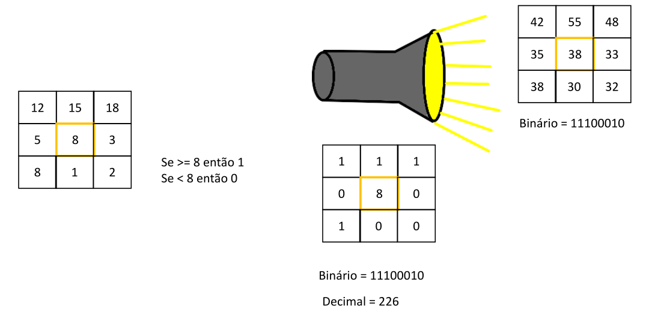
Local Binary Patterns Histograms
Binary
if >= 8 then 1
If < 8 then 0
Binary
Decimal

Slide 9
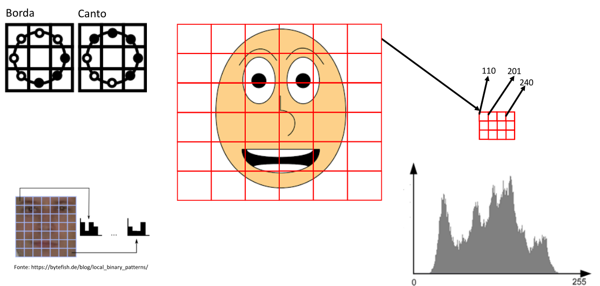
Local Binary Patterns Histograms
Edge corner

Slide 10
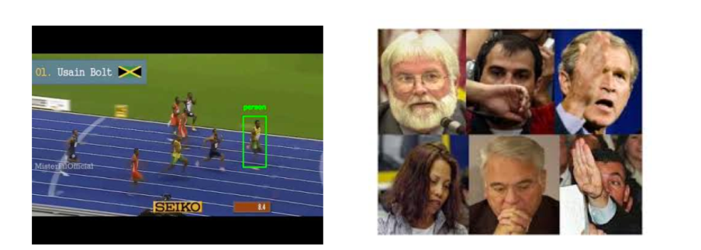
Object Tracking
• Faster than detection algorithms
• Detection algorithm always “starts from scratch”
• Tracking uses previous information

Slide 11
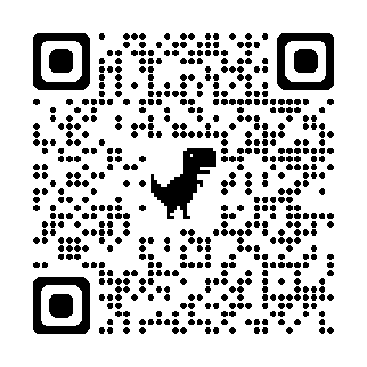
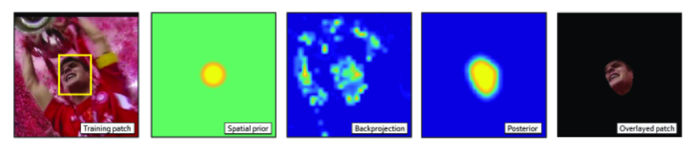
Algorithim CSRT
DISCRIMINATIVE CORRELATION FILTER WITH CHANNEL AND SPATIAL RELIABILITY
1. From left to right: training patch with the bounding box of the object to be tracked
2. HOG to extract useful information from the image
3. Posterior object probability after the Markov random test
4. Training patch masked with final reliability map
Article
https://www.arxiv-vanity.com/papers/1611.08461/

